Slide 1

SPOTIFY
MUSIC
Davyd Voloshyn, Anna Pederson, Asher Cohn, Neo Zhu, Henry Woodburn, Ian Hutter

Slide 2

SPOTIFY
602 Million Monthly Users
82 Million Songs
What makes a song successful?
11 Million Artists
Is there a formula for a songs success?
What are the trends in the music industry?

Slide 3

How does music production differ around the globe?

Slide 4

Our
DATA
Source
Methodology
Description
Original Dataset came from Kaggle
Published Salvatore Raselli, Marco Guarisco, and Marco Sallustio
Collected by web scraping
Originally from YouTube and Spotify on the 7th of February 2023
Top 10 songs for different Music Artists
Song Characteristics and Performance Metrics

Slide 5
Merging
We were interested in analyzing the genre of the songs, nationality of the singer, and the year it was written.
We merged that dataset with other datasets that were posted by Kaggle users scraped from Spotify.
The genres were very specific and had singular observations, so we grouped them into bigger brackets according to Grant Simmons' online genre list classification.

Slide 6
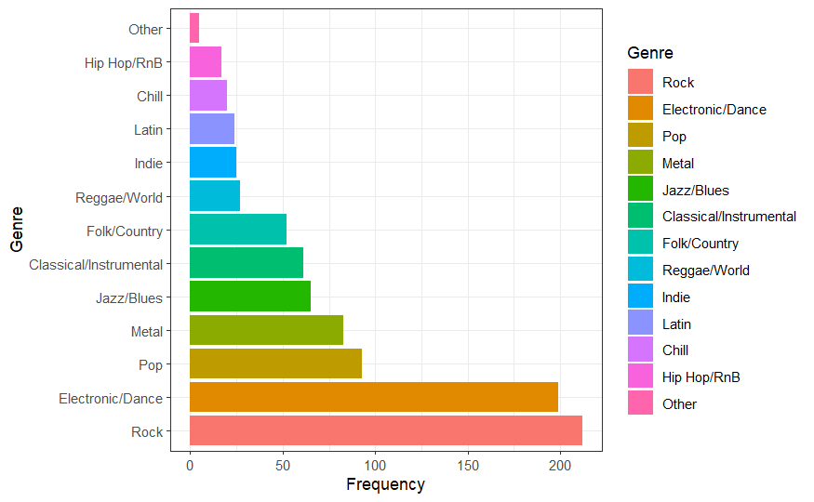
Genre Distribution
This table demonstrates the distribution of the Genres by frequency, with Rock and Electronic/Dance being the two most frequent genres.
Notes:
Working on smth better; but let it sit there for now

Slide 7
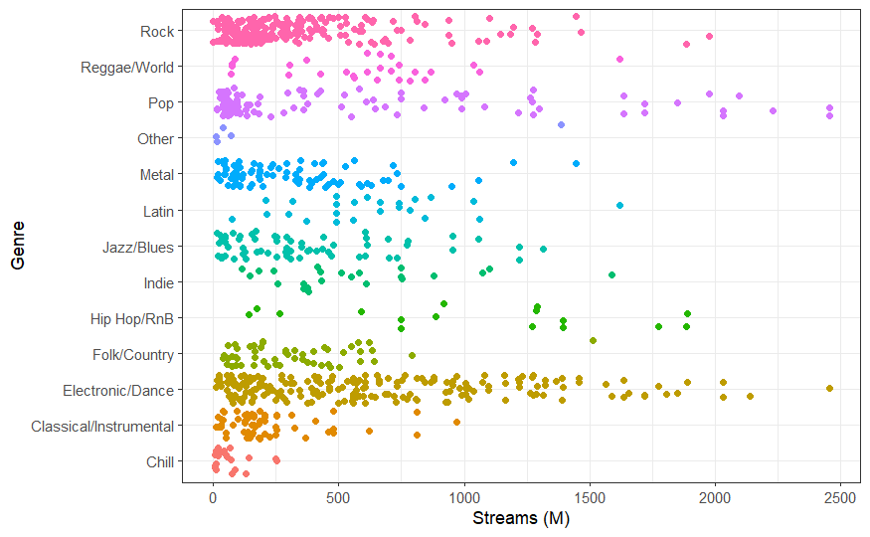
Streams in Genre
This table demonstrates the distribution of streams in the different Genres. Pop reaches the highest streams, with Electronic/Dance, Rock, and Hip Hop also receiving significantly high streams.

Slide 8
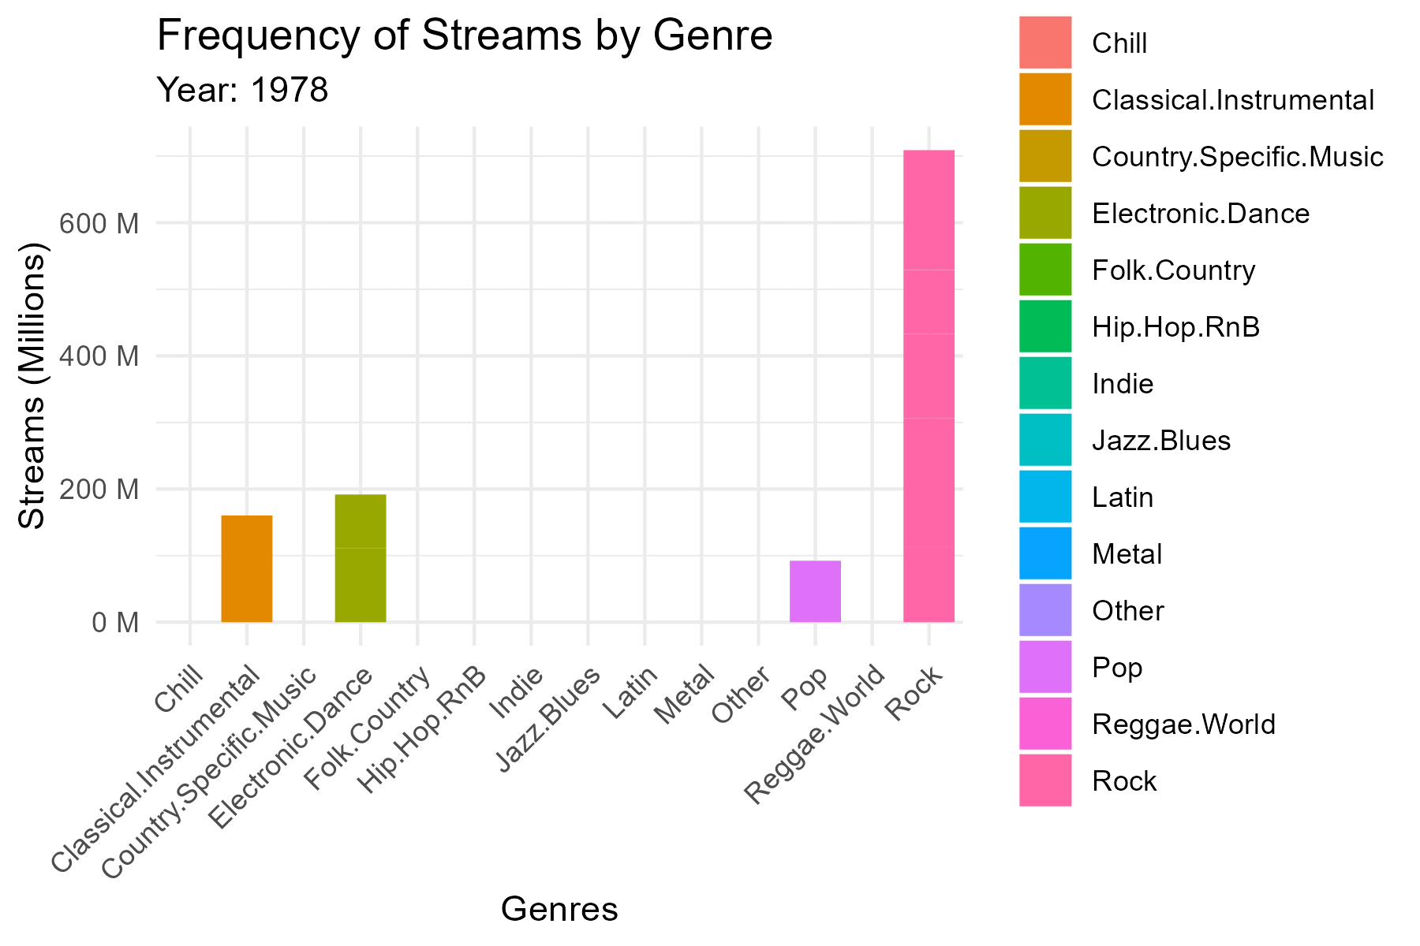
Streams in Genre by Year
This table demonstrates the distribution of streams in the different Genres by year. We found that the common trend was that Rock dominated the 1970’s to early 2000’s until pop and Electronic/Dance music took over the new era of music that plays on our everyday car stereo.

Slide 9

Map Methodology
Why
What
How
Examine the distribution of the genres of songs throughout the world and identify trends.
Average popularity of the songs in our data set for each genre and nationality of artist
We used the leaflet package in R, along with a downloaded geoJSON map

Slide 10
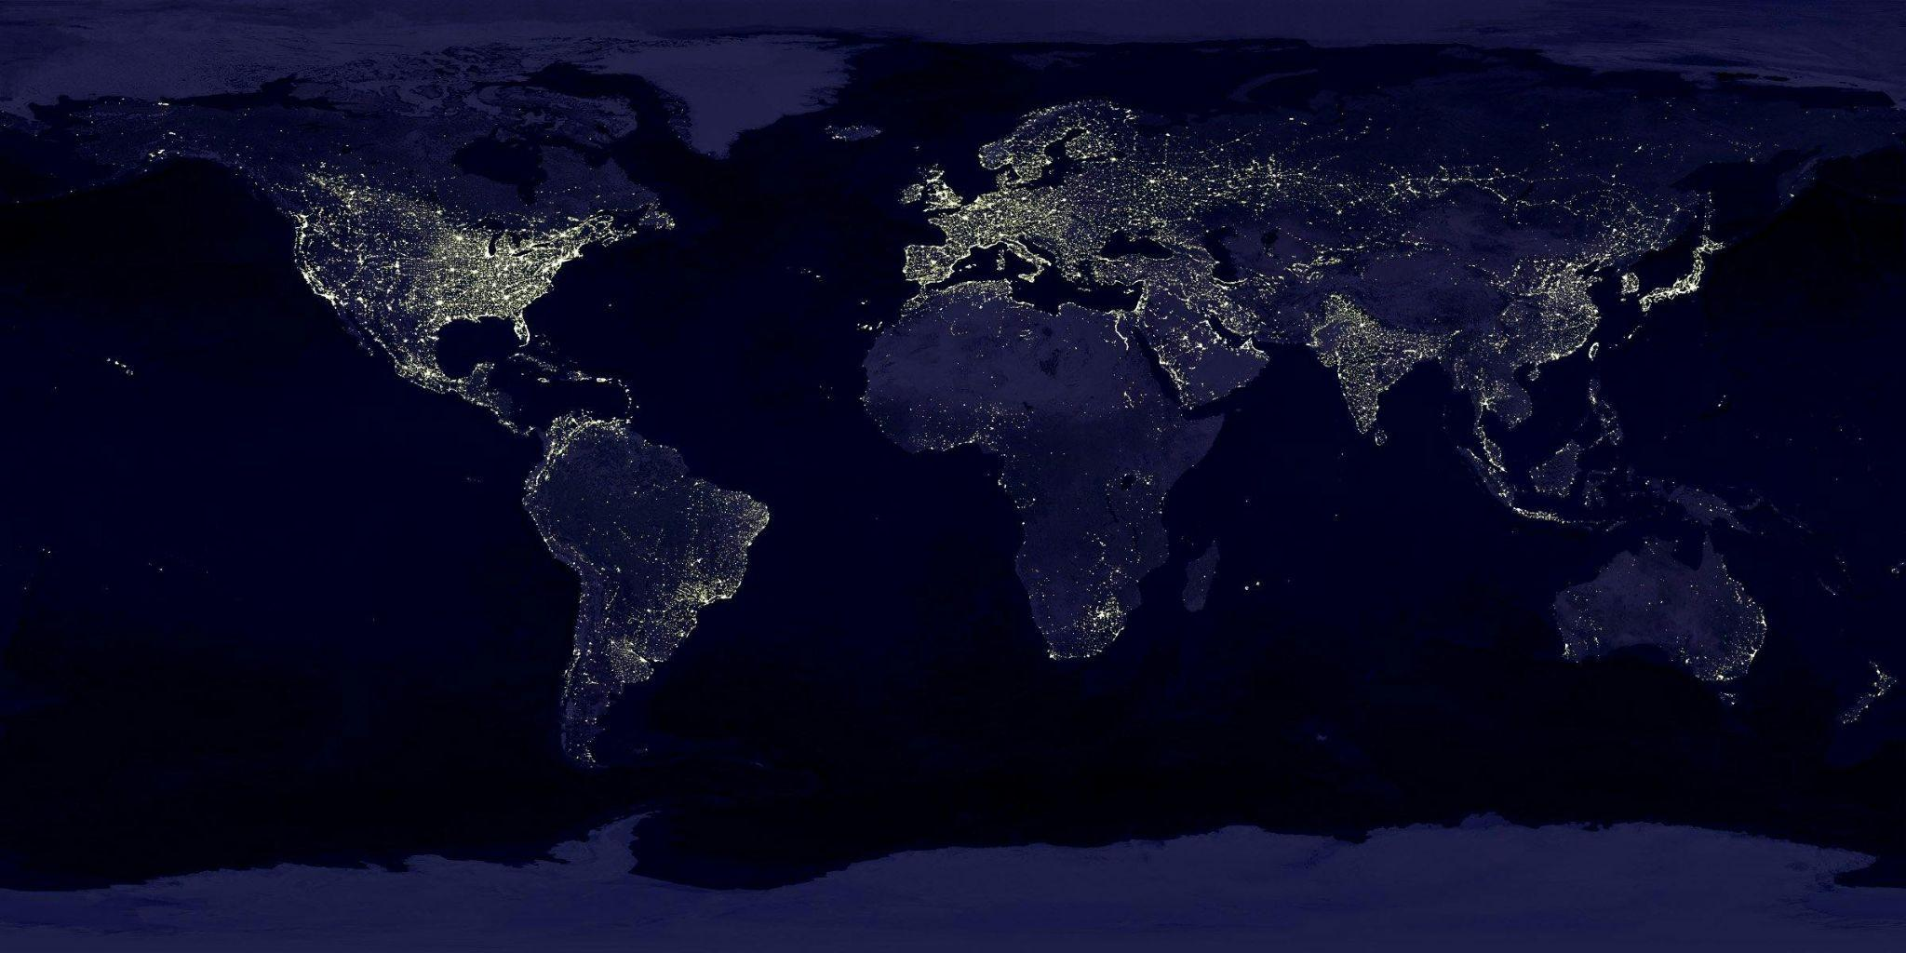
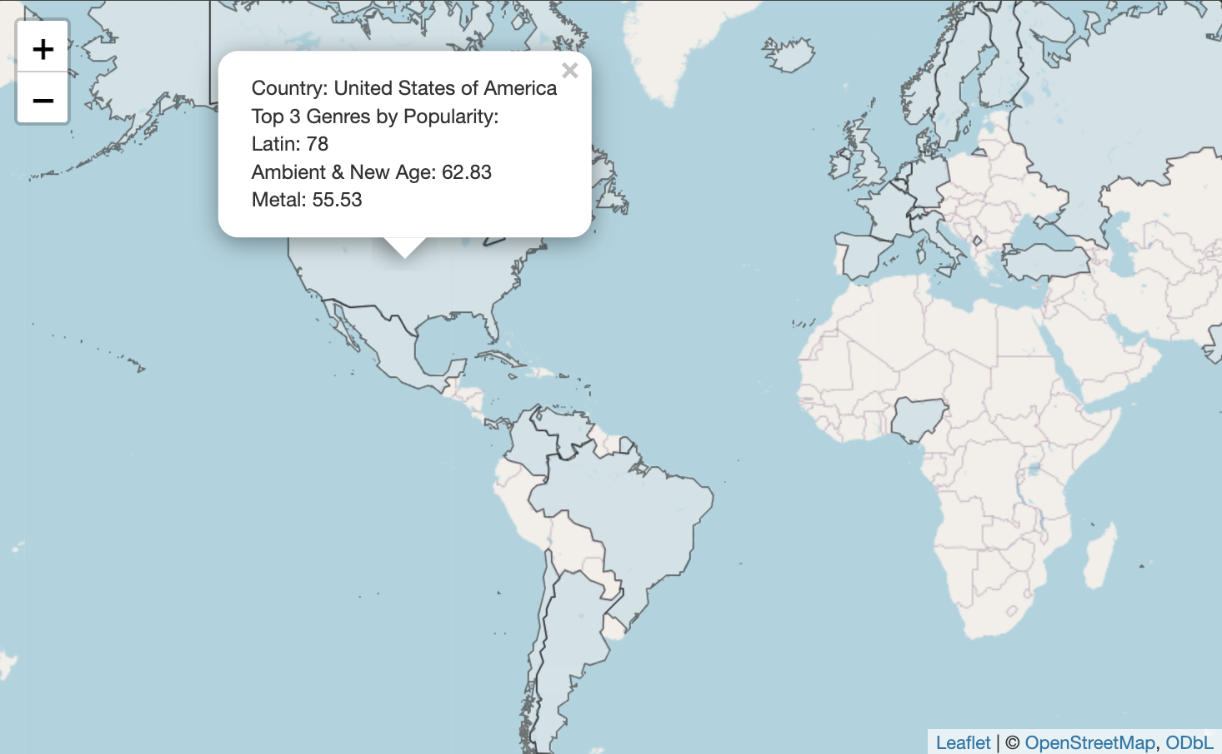
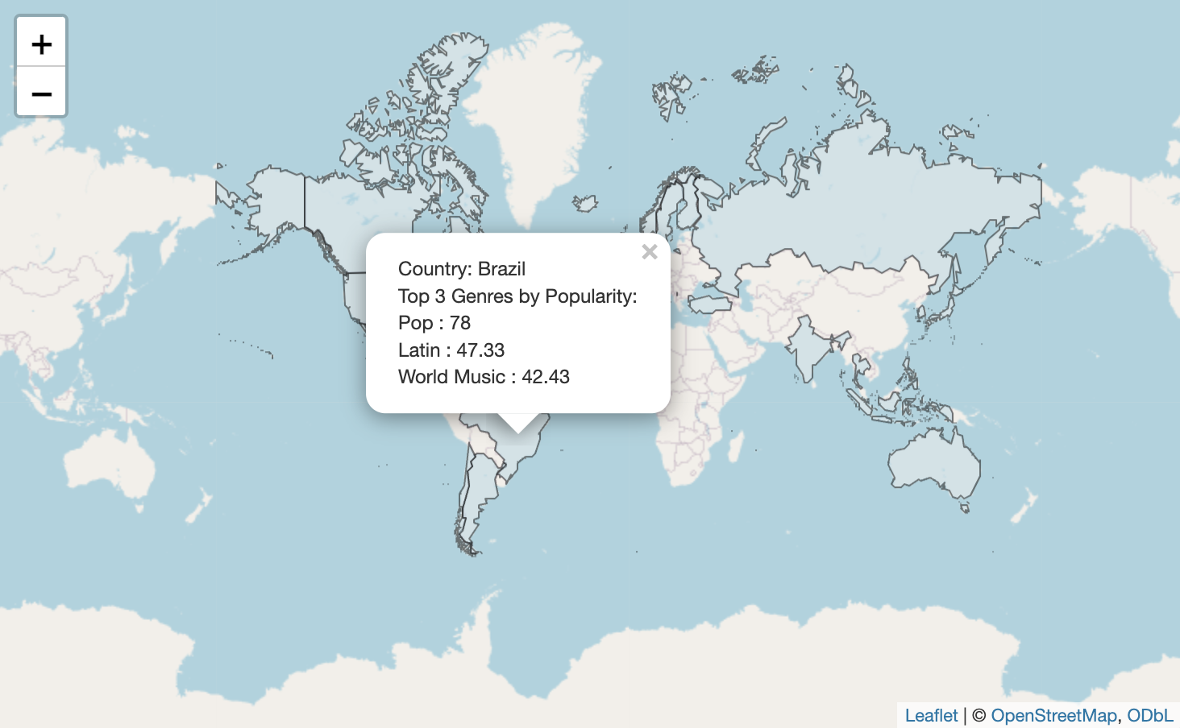
United States
More Results
The Latin genre had success in multiple countries like the U.S. with an average popularity rating of 78.
This followed the trend of high energy genres performing well
Electronic & Dance and Pop performed well worldwide
Pop topped the list of many countries, including South Korea, which we expected, as sub-genres such as Kpop were grouped into the Pop genre

Slide 11

More Results
The Latin genre performed well and was in the top 3 for many countries, including the United States
It can be seen that music taste around the globe continues to evolve and shift away from more Classic genres
The Rock genre underperformed expectations even though it is one of the bigger genres in the data set

Slide 12
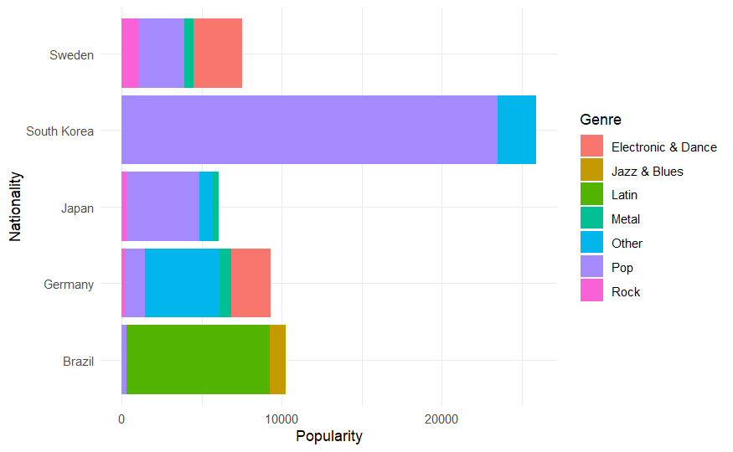

Slide 13
